Slide 1
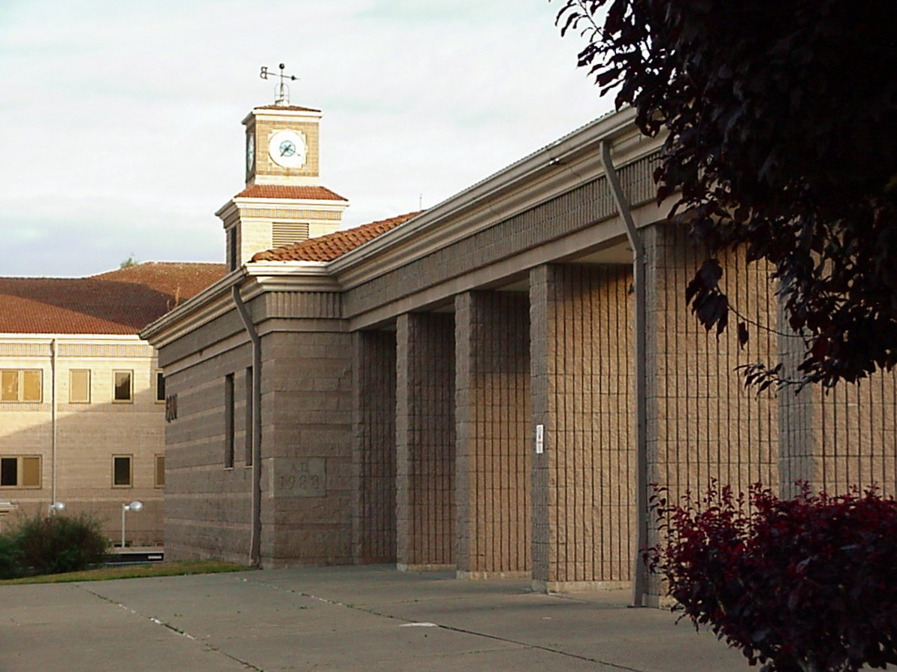
Identifying and Publicizing Centers of Excellence In Public High Schools
By Mark Warns
©2011

Slide 2
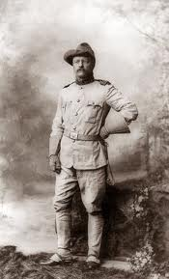
Centers of Excellence in Public High Schools
“Centers of Excellence” is designed to shine the light of day on positive programs hidden within our public high schools. It will highlight existing programs in our public high schools that are already achieving superlative results for students. It will be a valuable resource for parents, helping them navigate the confusing array of paths available to their children in our public high schools by showing them which programs – in place right now, right there – are already achieving the best results for their students.
“Do what you can, with what you have, where you are.”
Theodore Roosevelt

Slide 3
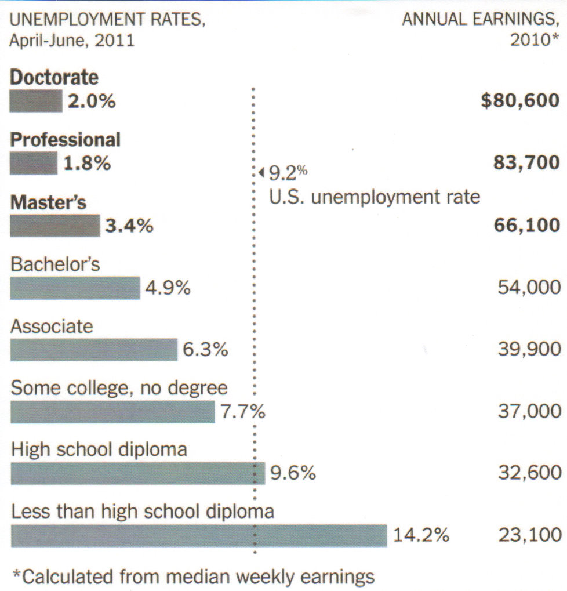
Centers of Excellence in Public High Schools
Here’s why higher education matters:
p

Slide 4
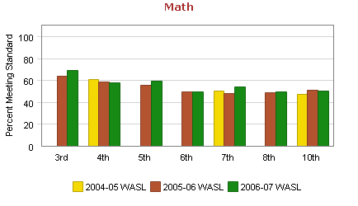
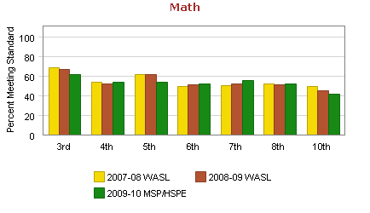
Centers of Excellence in Public High Schools
And how are our schools doing here in Washington?
These graphs show the pass rate for the math section of the learning assessment test for Washington. They cover six years of tests from 2004 through 2010, and they show that, during those six years:
- Statewide scores for math have peaked in the third grade and gone down each grade since.
- Recent scores in the third and tenth grades are almost 8% lower than they were in ‘06-’07, losing 2% per year.

Slide 5
Centers of Excellence in Public High Schools
Re-capping what we’ve gone over so far:
- Our culture and our economy place an extremely high value on educational achievement; and
- In key respects, the overall performance of our school systems is weak and getting weaker.
Additionally, students are only in middle school and high school for seven years, which isn’t enough time – even if their schools had the will and the resources – to turn their whole educational system around in time to benefit our students.
Given that, what can parents do today to make sure their kids are in an educational environment that fosters excellence?
They can find the programs in their own schools that already work, programs that are achieving excellent results already, and they can steer their children toward those programs now.
Here are two examples of existing Centers of Excellence:

Slide 6
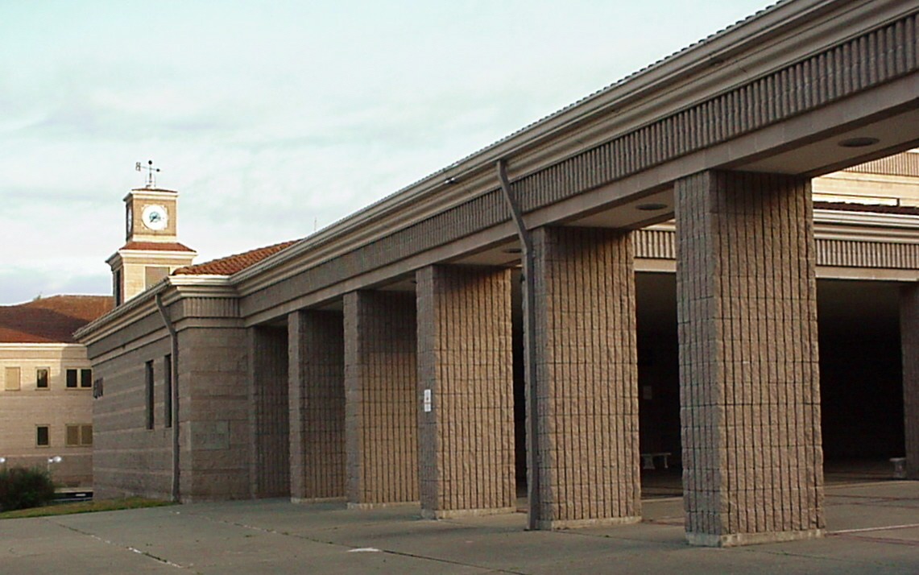
Centers of Excellence in Public High Schools
But there’s some good news in our high schools too.
Here’s a Center of Excellence in Bremerton:
The “Avid Program,” run by one teacher at Bremerton High School, a school with below-average scores, stands out as a Center of Excellence. The AVID Program is targeted at the children of non-college households who want to be the first students in their families to receive a college education. Even though these students enter high school with mid-range grades and scores, the results achieved by them are outstanding. No Avid Program student has ever failed a state learning assessment test, all students have graduated on time, and all have gone to college.

Slide 7
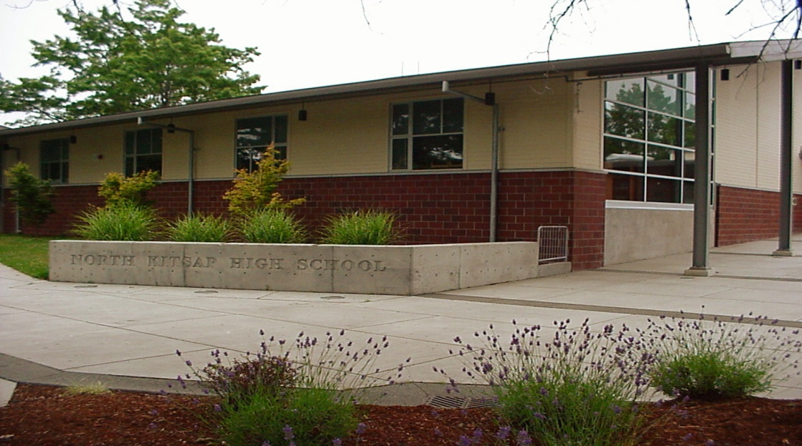
Centers of Excellence in Public High Schools
And here’s a larger Center of Excellence in Poulsbo:
Students at North Kitsap High School usually score a little higher than the state average on learning assessment tests. But the North Kitsap Band Program is a Center of Excellence. In fact, if the 140 band kids formed a single high school, they would do better on learning assessment tests, have higher average grade-point-averages, and have the highest percentage of students going on to college of any public high school in Washington.

Slide 8
Centers of Excellence in Public High Schools
Everybody with an interest in better education is saying:
“Sounds good to me,
but where’s the list?
Where’s the list of all the programs in my
schools that foster and achieve excellence?”
The answer is that there isn’t a list…yet.

Slide 9
Centers of Excellence in Public High Schools
Building a list of programs like that for one high school in Kitsap County is my goal for next term.
I think that list will have a lot of value for parents of kids who are in that school or expect to attend that school, and I hope that method and that list, will prove to be a model for other schools and school districts around our state.
But I’m only one parent with an interest in education, and it will take more personnel with more horsepower to expand the idea, so I’ll also be looking for a college or university education department to also embrace the idea.

Slide 10
Centers of Excellence in Public High Schools
These are the numbers I need to collect at that high school.
Baseline data needed for all students:
Average GPA,
Pass rate for Math Section of High School Proficiency Examination,
On-time graduation rate, and
Percentage of graduates going on to college.
The same data will be needed for all school activities, but I will not accept…
Data mentioning or identifying individual students, and
I will return all data on programs that underperform the school’s overall averages since the idea is to praise successful programs, not to embarrass the less successful programs.

